Slide 1
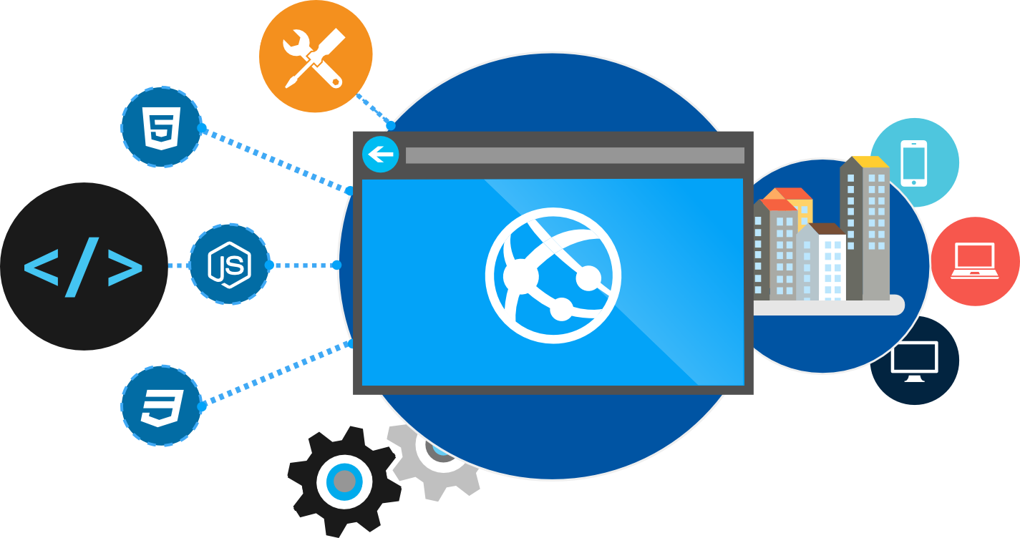
Containers and Azure Container Service
Josh Lane
Cloud Academy
@jplane

Slide 2


Instructor - Josh Lane
Cloud Academy Instructor
Architect and developer
Consultant for finance, energy, hospitality, telecom, education industries
Microsoft Azure MVP
Azure-in-the-ATL meetup founder
Notes:
A brief note about your instructor. I’m Josh Lane, a Cloud Academy research and instructor. I’ve been a software developer focused on cloud and data technologies for several years, and have worked around the world for clients in industries such as energy, finance, and more. I was awarded Microsoft’s Azure MVP designation for both my development work and my activities promoting cloud and Azure technologies in the technology community. Thanks for attending the course!

Slide 3

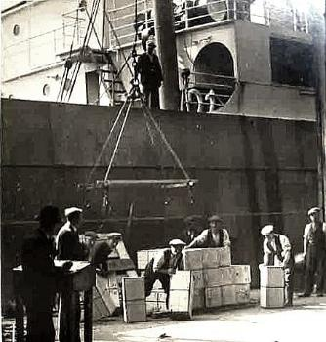
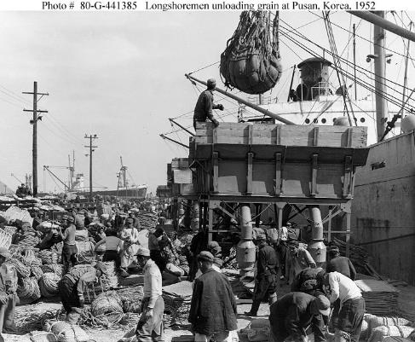
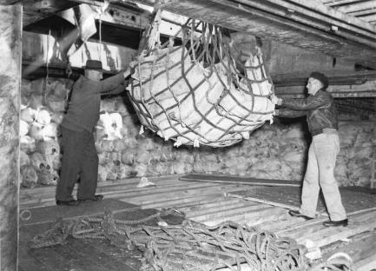
Before Container Standards
Notes:
Going to take you back to a time before shipping standards were in place.
Everything was loaded individual. Took lots of man power. Items would get mixed and matched. Items would be all over the ship.

Slide 4
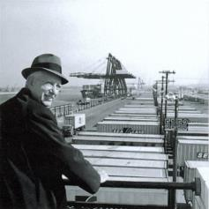
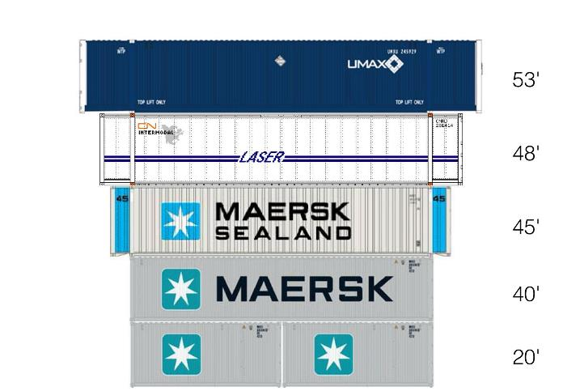
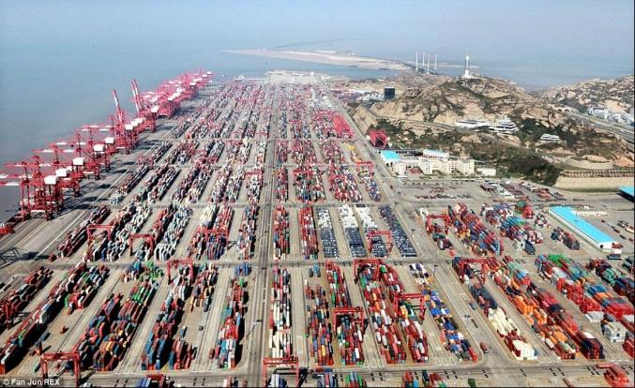
Shipping Containers Invented
In 1956, most cargo was loaded and unloaded by hand. Hand-loading a ship cost $5.86 a ton.
Malcom McLean born in 1913 developed the modern intermodal shipping container, which revolutionized transport and international trade.
McLean knew "A ship earns money only when she's at sea," and based his business on that efficiency.
Using containers, it cost only 16 cents a ton, a 39-fold savings. Containerization also greatly reduced the time to load and unload ships, improving reliability.
https://en.wikipedia.org/wiki/Malcom_McLean
Notes:
It was such a tough and demanding process that the were able to cut the savings by 39X. Imrpoved reliability by putting everything in the same conatieers. Faster load process.
It was so revolutionary that today we can’t event image a situation with containers.
Container techonology in software is likely to feel the same way in a few years. We won’t be able to dream a time with out it.
As far as the cost saving goes I would say that you would likely see something similar if we were as good about tracking cost and effort in software. Im not sure that many of us are thought we are moving forward as in industry.

Slide 5
App A
App A’
App B
Containers are isolated, but share OS and, where appropriate, bins/libraries
Bins/Libs
Bins/Libs
Bins/Libs
Guest OS
Guest OS
Guest OS
App A
App A’
App B
App B’
App B
App B’
App B
App B’
Bins/Libs
Bins/Libs
Hypervisor
Docker Engine
Host OS
Host OS
Server
Server
Notes:
We have had a similar technology through the use of VM’s in the past but it was very heavy weight. It is like have a boat carry boats of boats full of shipping containers. Big beefy machines to hold other machines
With container technologies, to solution is much more light weight and is more like having the containers directly on the boat. You get a higher density of applications/verisons/services on one machine. This becomes really important for two reasons. First one is cost saving on you part. Less hardware is a good thing. Second we you start to talk at the scale like amazon or azure it means they can have higher density and that adds up quick and passing off saving to you.
Another thing to note here is the share bins libraries.

Slide 6
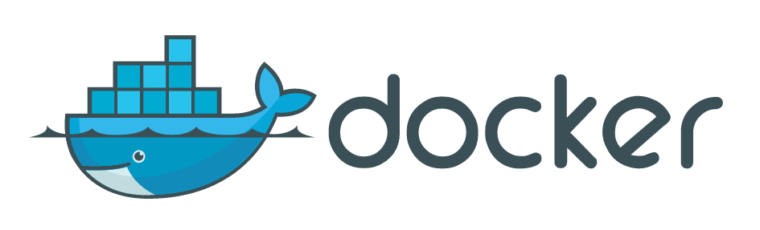
Notes:
Hopefully docker’s logo makes sense to you now.

Slide 7
Why Containers?
Fast performance and startup
Portable across host environments
Density of container deployments = fewer servers
Better dev cycle thru dependency mgmt. and self-containment
Better ops cycle with support to build, (un)deploy, version, and monitor

Slide 8
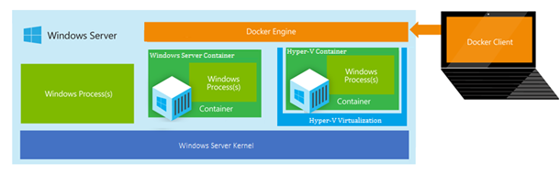
What about Windows?
Windows Server Containers - More density, less isolation
Hyper-V Containers – More Isolation, less density
Both just communicate using the Docker client/engine

Slide 9
How do containers make it easier?
Consistency
Efficiency
Rapid
Deployment
Fast Iterations
Service Separation
High Availability
Reproducibility
On Any Cloud
Scalability
Test at Scale
Immutability
Reduced Costs
Notes:
Reporducibility
Immutabliy
On an cloud
Scalablitliy
Reduced costs - desinity

Slide 10

Containers and Devops
Creation, deployment, and management
Developers update, iterate, and deploy updated containers
Physical/Virtual Servers
2
3
Operations collaborates with developers to provide app metrics and insights
Developers build and test apps in containers, using development environment
Operations automates deployment and monitors deployed apps from central repository
1
2
Containers pushed to central repository

Slide 11
Terminology
Docker Containers Actual running instance of a container (writable)
Docker Images ready-only (Immutable) templates that help define Docker containers
Read-Write Layer
Container
4
Read Layer
3
Read Layer
Image
2
Read Layer
1
Notes:
There is a lot more to this but for now that is all you need to know.
Think: objects are instantiation of class. Containers are instances of images.

Slide 12
Docker Terminology
Host Place where containers run
Client Used to interact with Host
Registry Repository of images
Container Running application instance
Image ready-only template from which a container is created
DockerFile Instructions to create an image

Slide 13
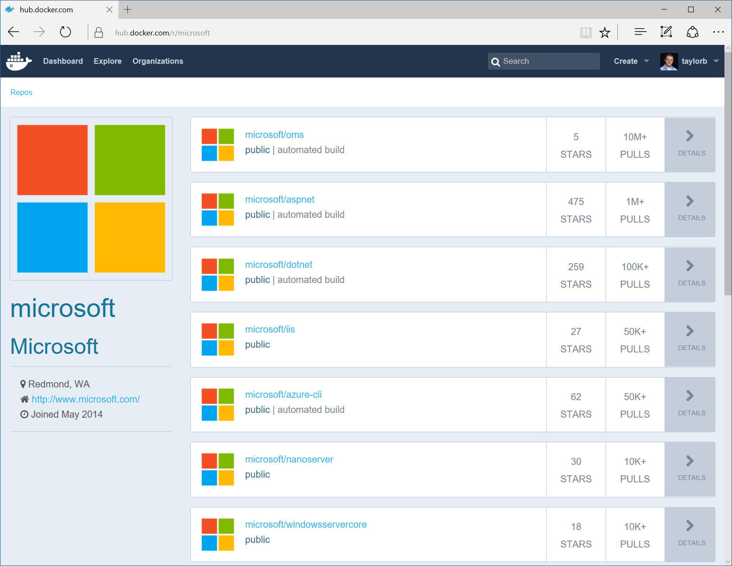
Image Registries
Docker Hub and Docker Store
Public, Official and Private image repositories
Docker Trusted Registry
Enterprise Grade Private Registries
Docker Registry
Open source foundation of Hub and DTR
Azure Container Registry
Store your container image in local, network-close storage on Azure
Notes:
Docker Hub and Docker Store
Public, Official and Private image repositories
Granular access controls with organization support
Automated image build support
Docker Trusted Registry
Enterprise Grade Private Registries
Runs on your infrastructure (on-prem or cloud)
Active Directory and Role Based Access Controls
Docker Registry
Open source foundation of Hub and DTR
Runs on your infrastructure (on-prem or cloud) as a container
https://docs.docker.com/registry and or https://github.com/docker/distribution
Azure Container Registry
Store your container image in local, network-close storage on Azure
Use Azure Active Directory to manage access
Manage Windows and Linux container images in a single registry

Slide 14
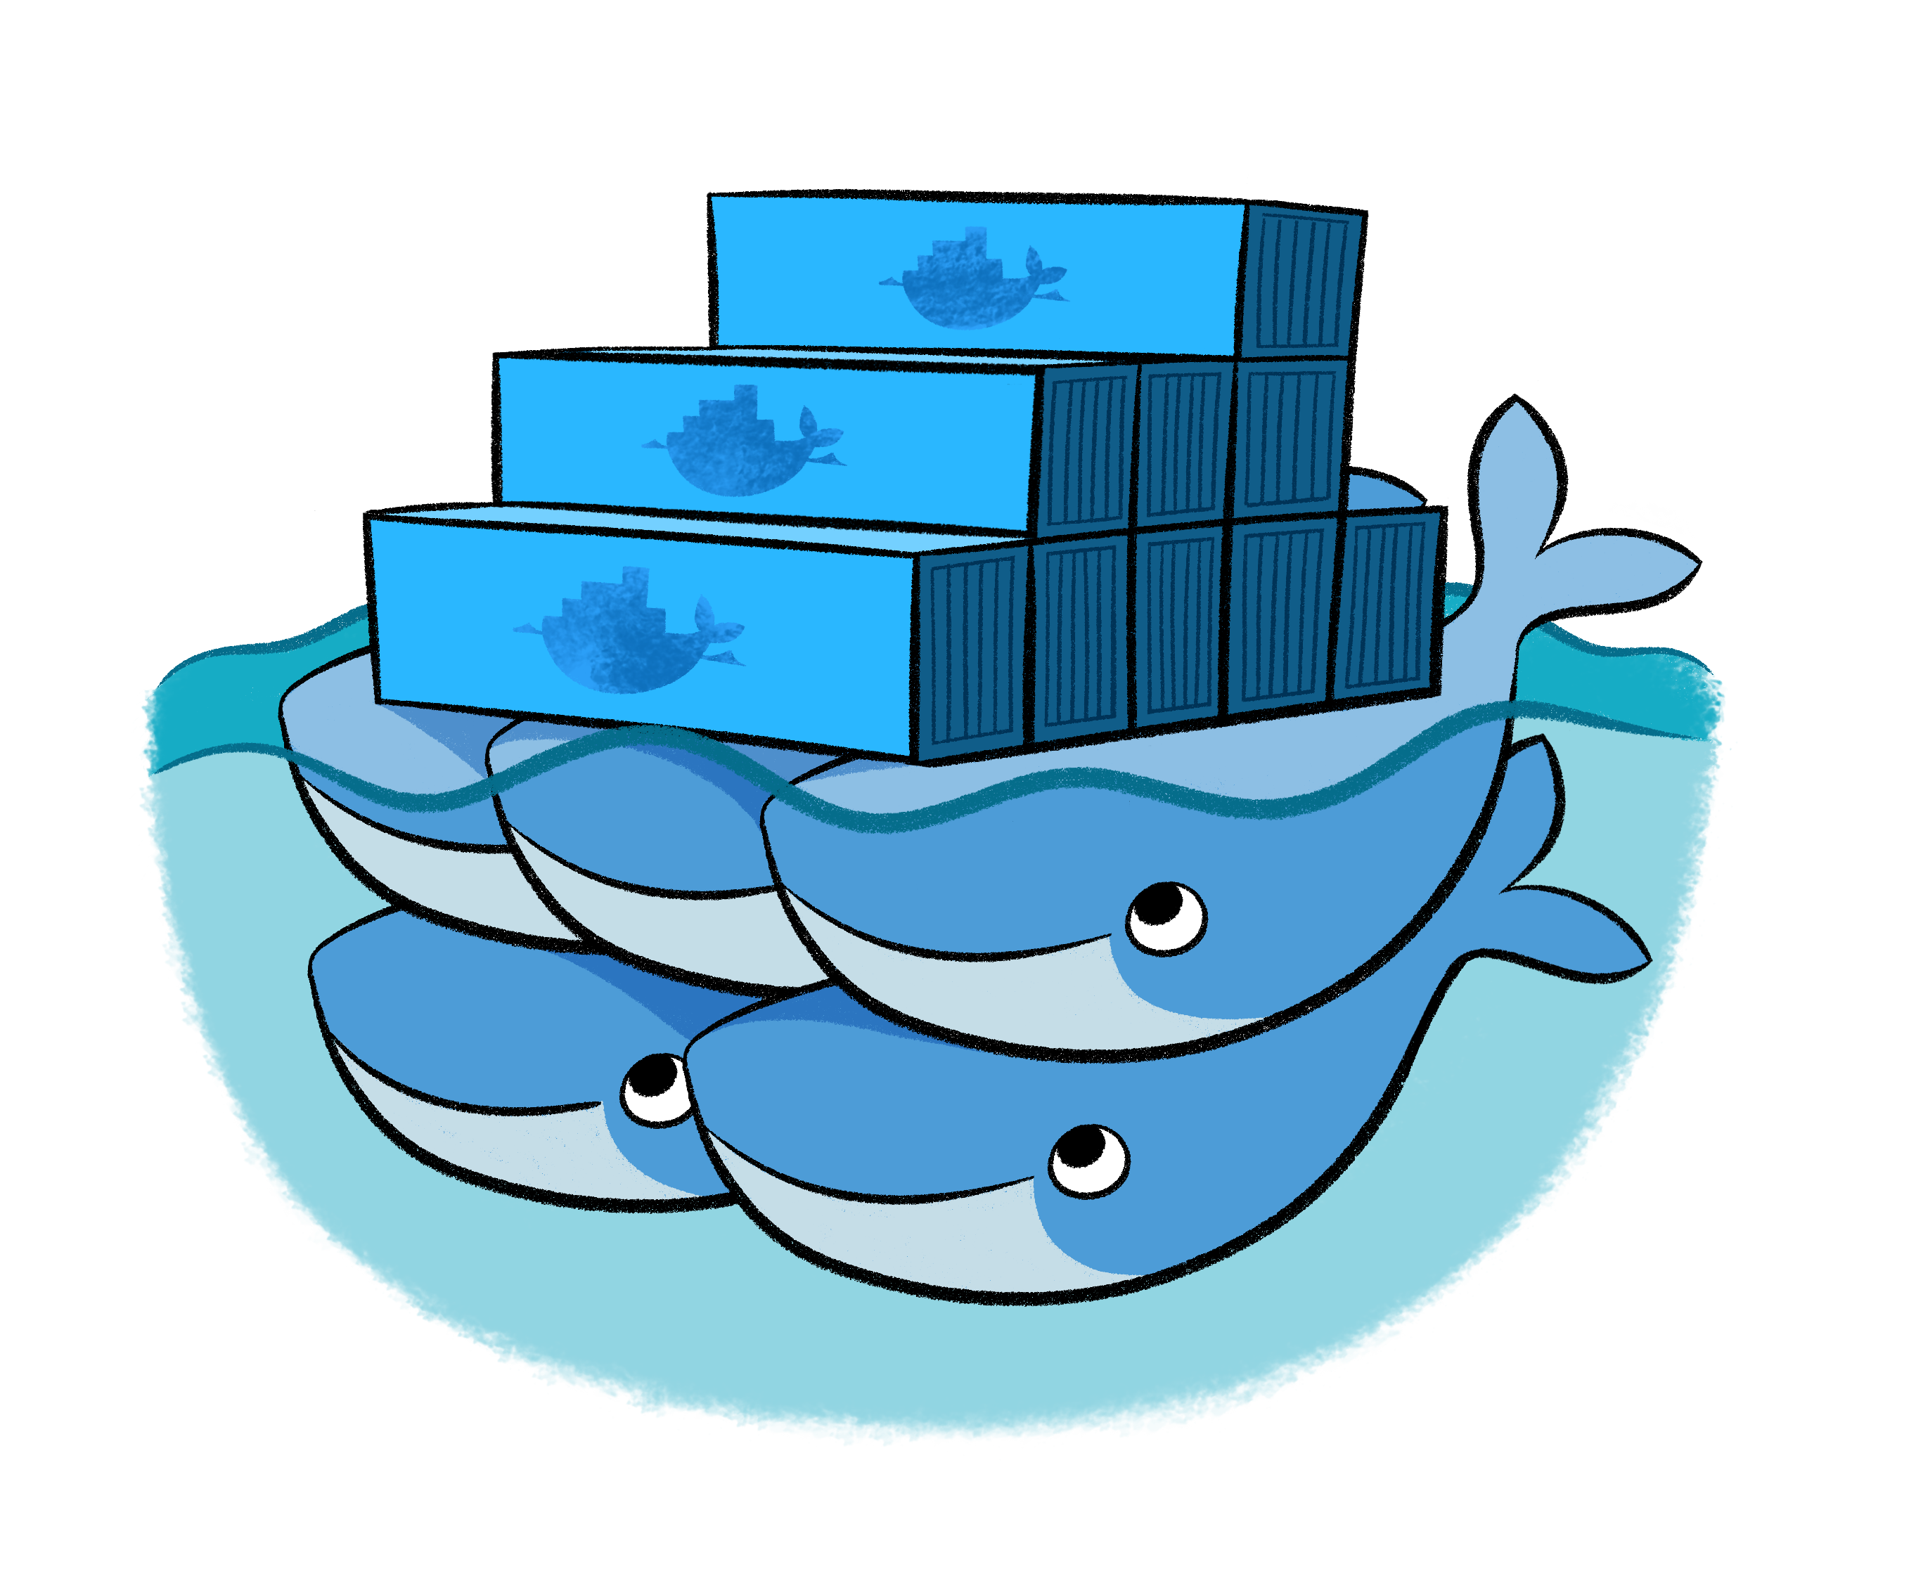
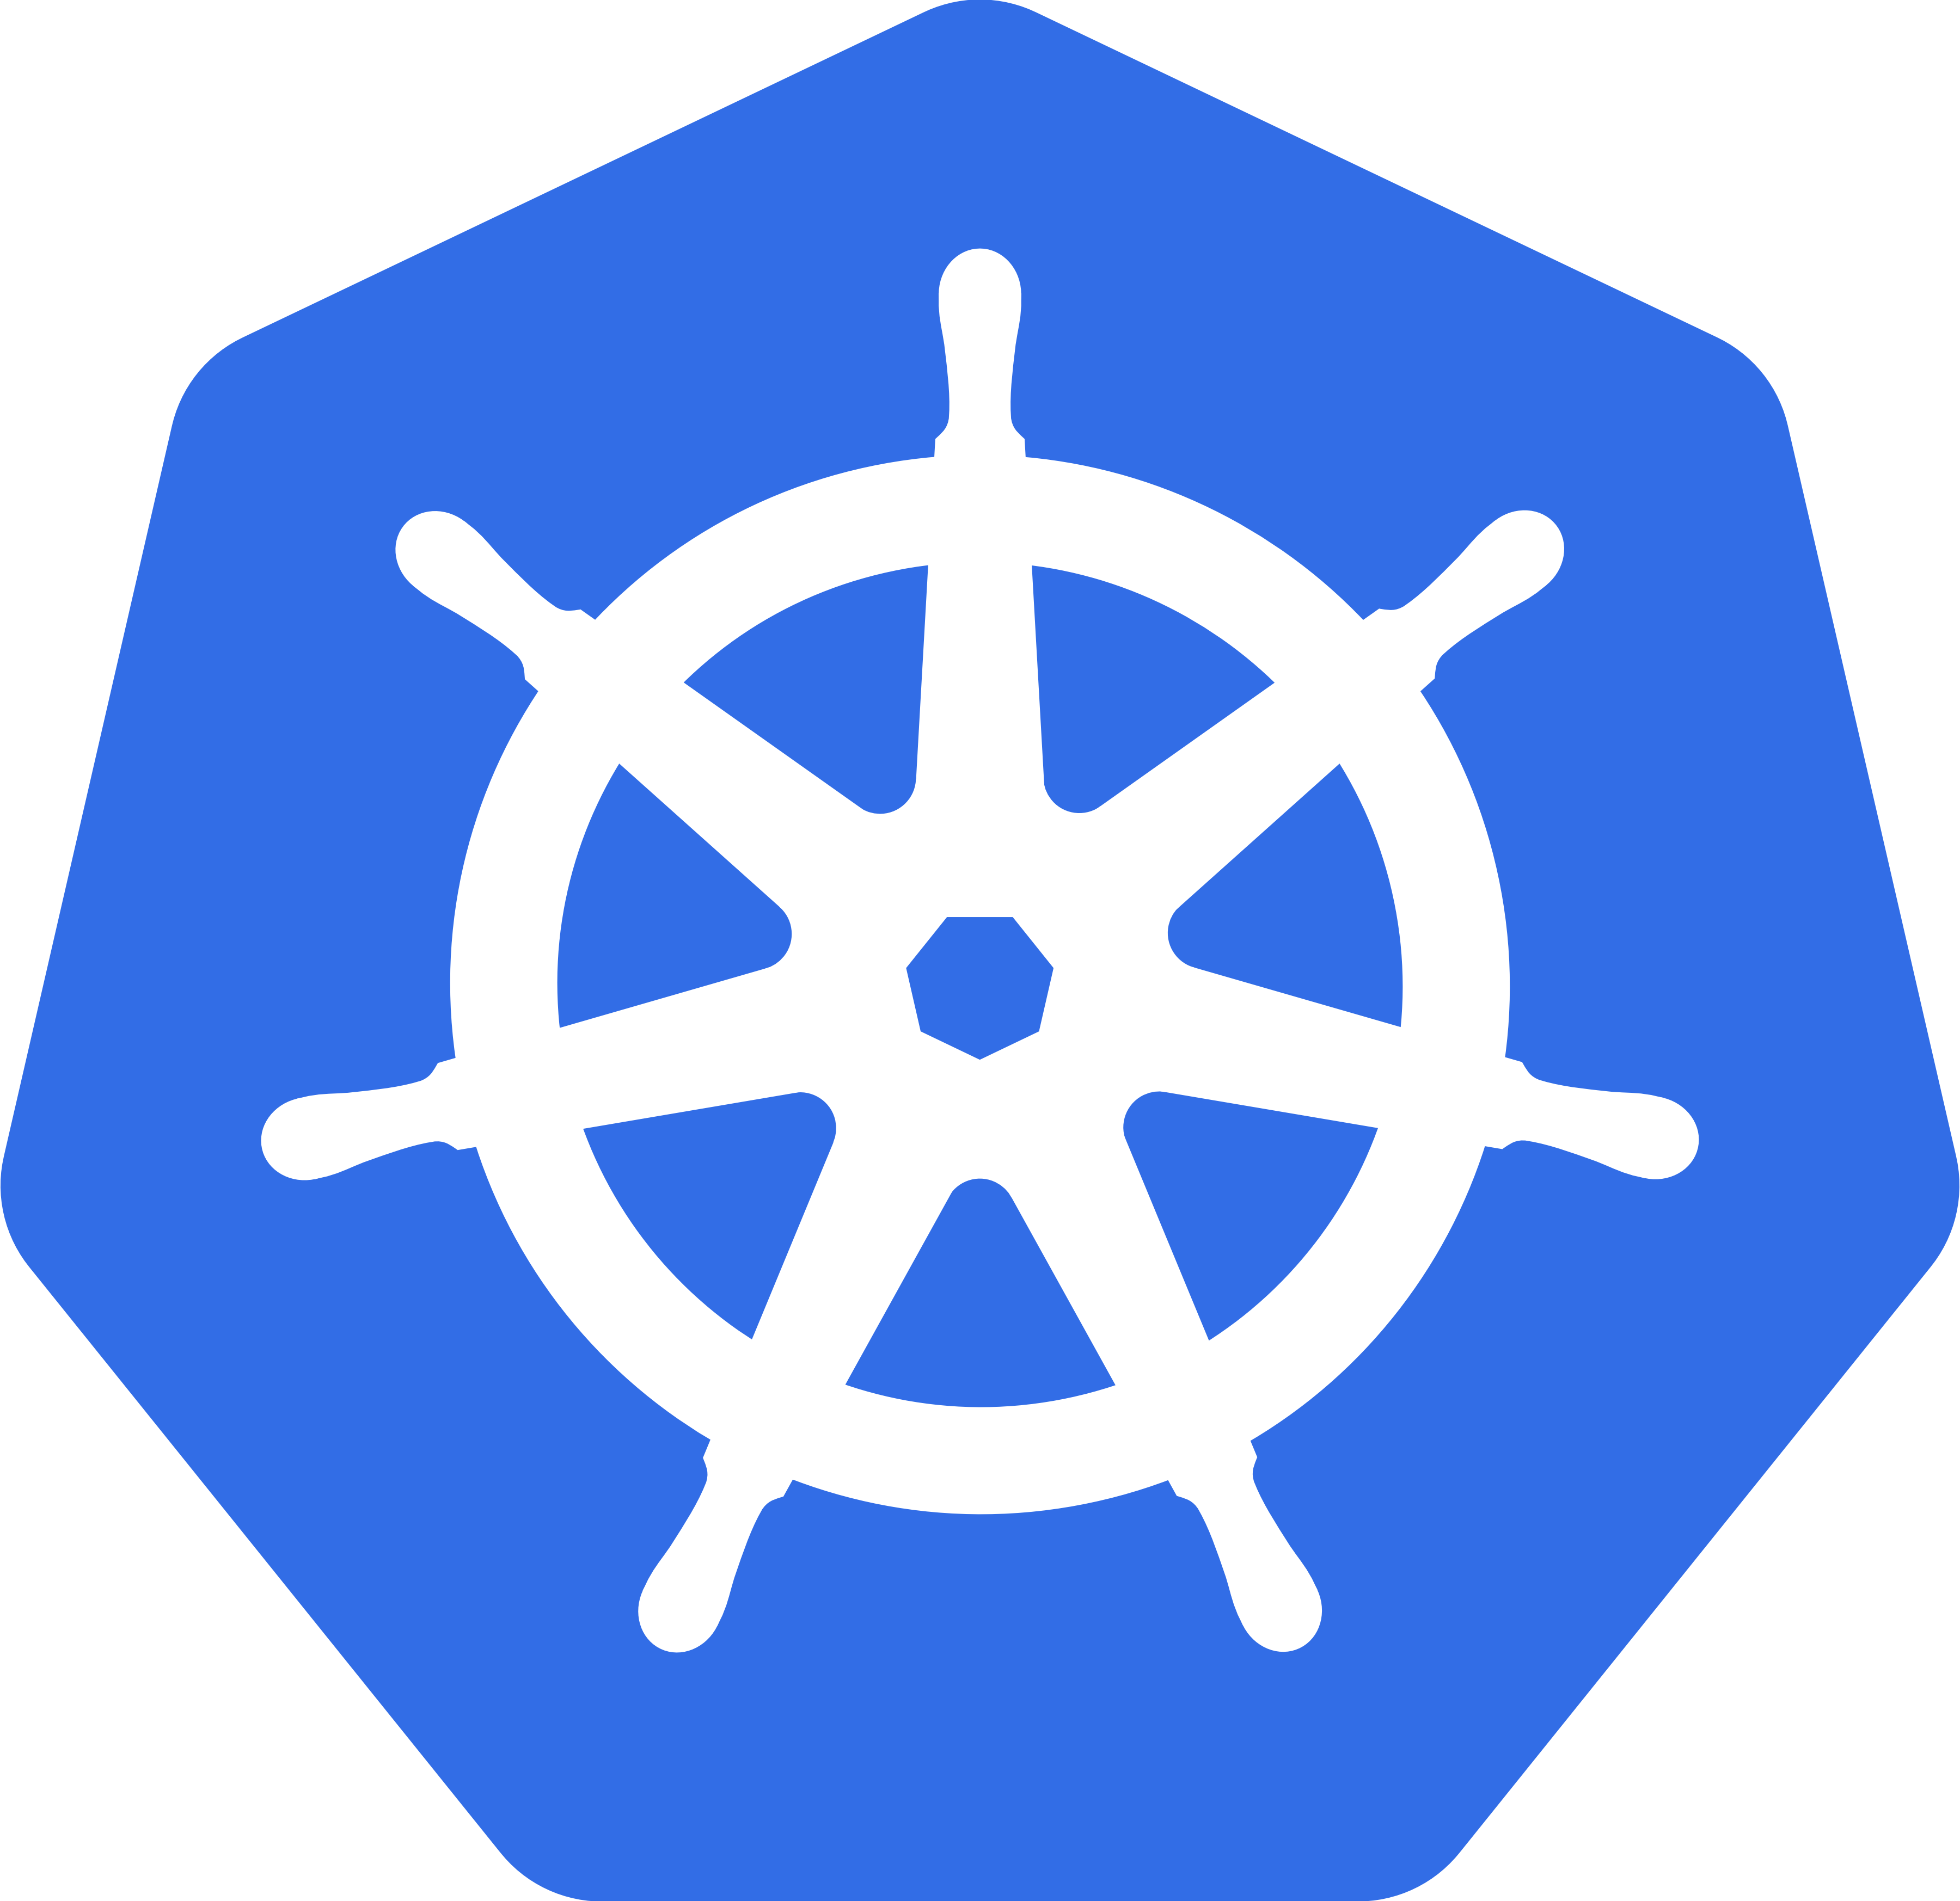

Containers on Azure
Linux/Windows VMs
Azure App Service
Service Fabric
Custom-deployed cluster
Azure Container Service
Docker Swarm, DC/OS, Kubernetes

Slide 15

Composition and Orchestration
Applications typically comprised of multiple containers
Containers typically hosted across a cluster of nodes
Orchestration tooling automates this

Slide 16
Why Orchestrators?
Abstraction of cluster to single management interface
Scheduling of container workloads on nodes in cluster
Security of containers from outside world, and each other
Monitoring of container lifetimes and integration with tools
Reliability of container workloads to ensure uptime
Scale of container instances in response to measured workloads

Slide 17
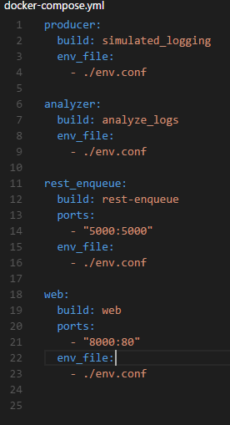
Composition and Orchestration
Docker Swarm
Aggregate container hosts
Supports tagging, affinity/anti-affinity

Slide 18
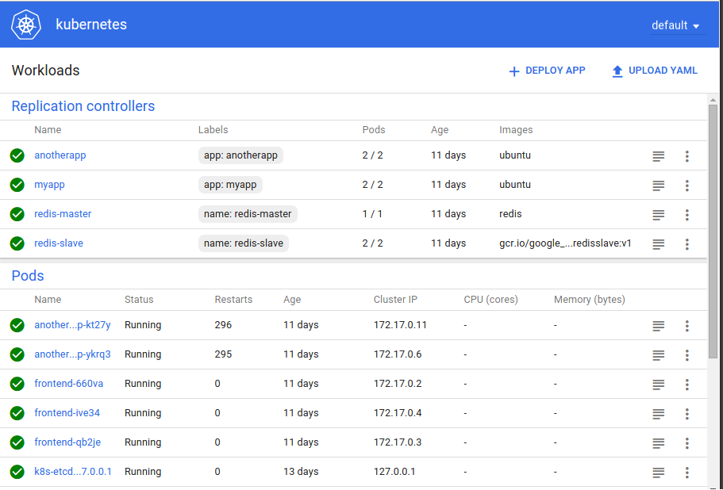
Composition and Orchestration
Kubernetes
Open source project started by Google
Windows support being added though community partnership spear headed by Apprenda

Slide 19
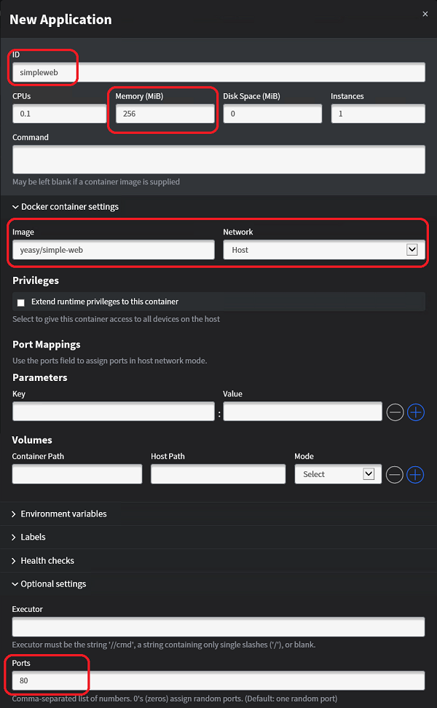
Composition and Orchestration
Mesos/Mesosphere + Marathon
Aggregates container hosts
Web based UI
Service Launch and Discovery

Slide 20
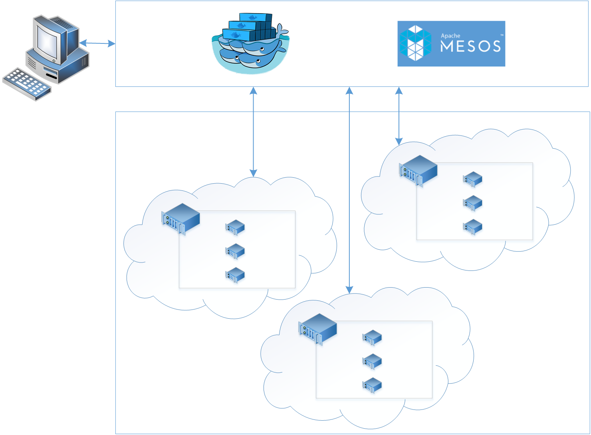
Azure Container Services
App1
App2

Slide 21
Handling machine failures
App1
App2

Slide 22
Additional Information
https://github.com/tripdubroot/ContainerCamp
https://docs.docker.com/
https://kubernetes.io/
https://docs.microsoft.com/en-us/azure/container-service/
https://github.com/Azure/acs-engine

